Slide 1
mining Internet of Things Data
Beiyu Lin

Slide 2
introduction to smart environment
What is a Smart Environment?
“a small world where different kinds of smart device are continuously working to make inhabitants’ lives more comfortable” by Cook and Das. (link 10’- )
Related to Ubiquitous Computing
“… a physical world that is richly and invisibly interwoven with sensors, actuators, displays, and computational elements, embedded seamlessly in the everyday objects of our lives, and connected through a continuous network.” by Mark Weiser et. al (link , - 1:23’)
Notes:
Ubiquitous (u – bit – quick – tis)
Actuator (act – true- ate – or)

Slide 3
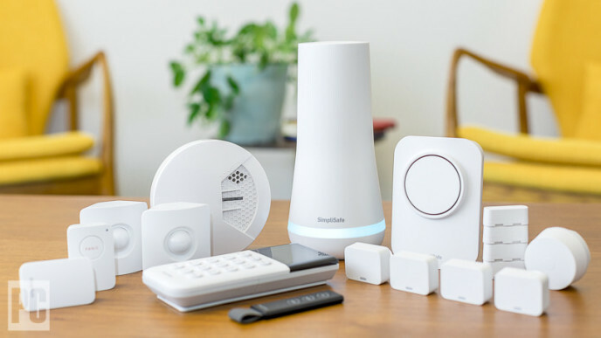
SMART ENVIRONMENT AND SMART DEVICES
Smart devices that
Connected to other devices via network protocols
Operate autonomously
Interact with
physical world (e.g., via sensors)
humans
each other

Slide 4
IoT based environmental monitoring
Monitoring Devices
monitoring systems consists a various device that generate signals which can be used for many monitoring aspects.
Using sensors supported by Bluetooth or Wi-Fi
Sensor Models
AirBot (link -- 3’00)
WaterBot
Sensordrone
Air Quality Egg (link
Lapka (link 20’- 3’25)
Wearable sensor (link 27’- 40 )

Slide 5

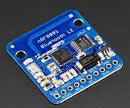
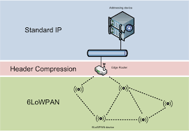
Communication Technologies
Bluetooth (less distance)
Bluetooth 4.0 LE (low energy)
ZigBee (extra distance; fast; reliable)
Wi-Fi (less reliable)
6loWPAN (IP-based network)
Z wave (fewer congestion problems)
Notes:
Six- low- pan

Slide 6
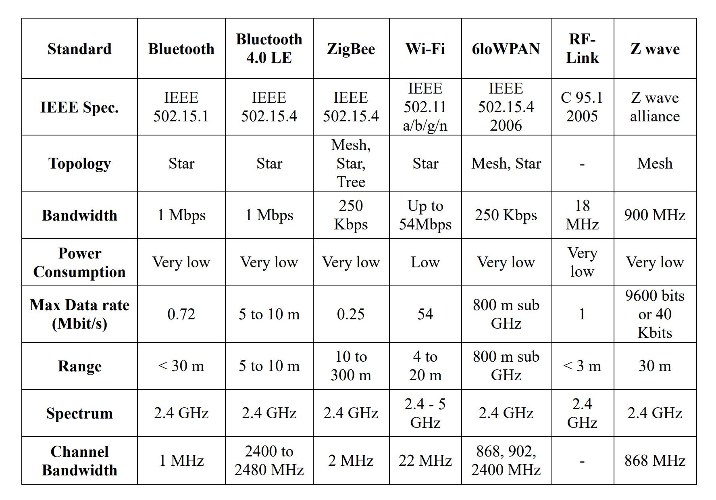
Communication Technologies

Slide 7
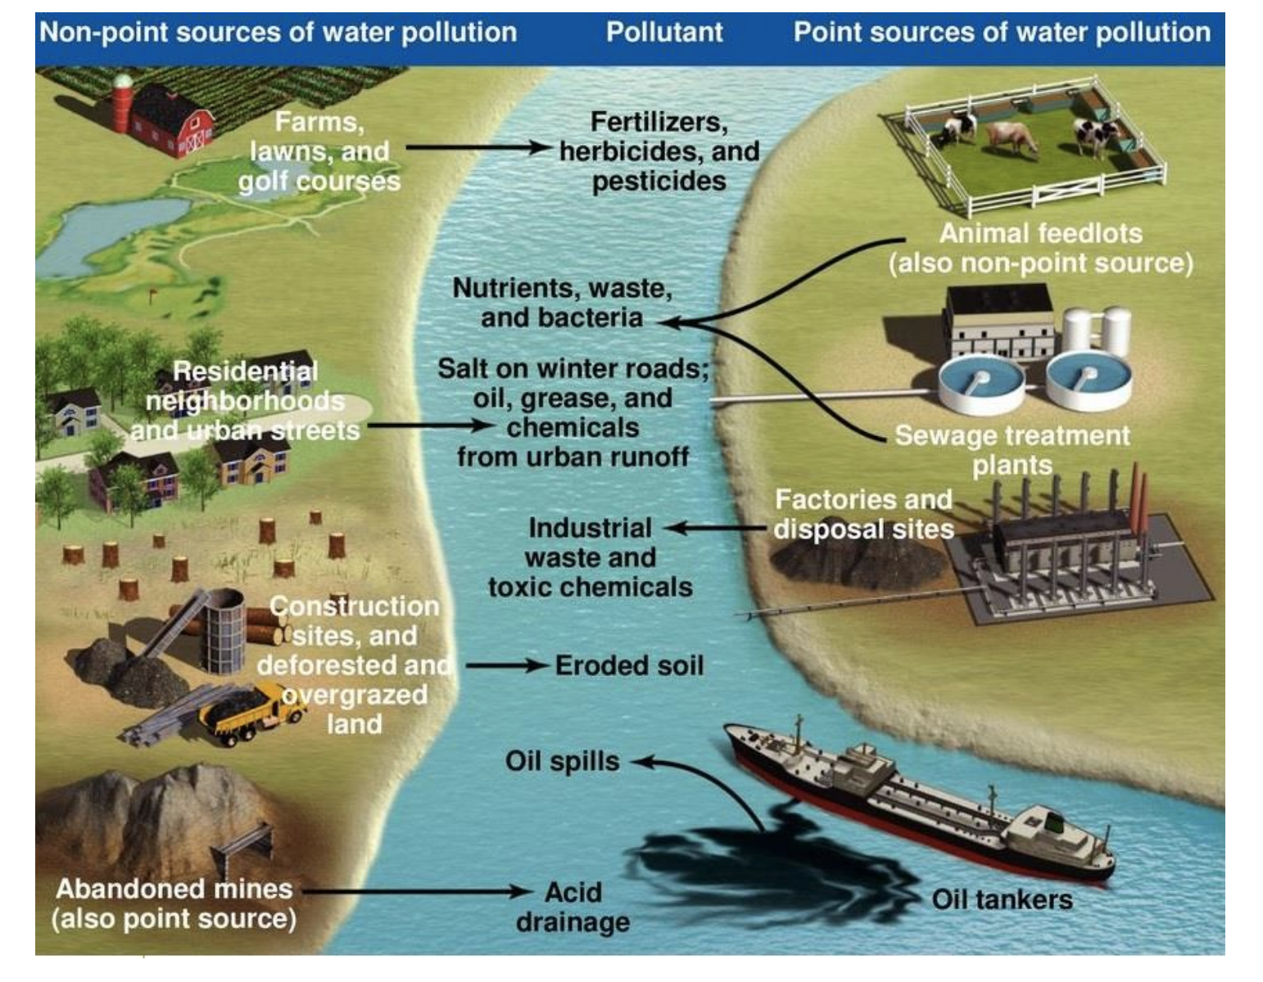
SMART City - WATER

Slide 8
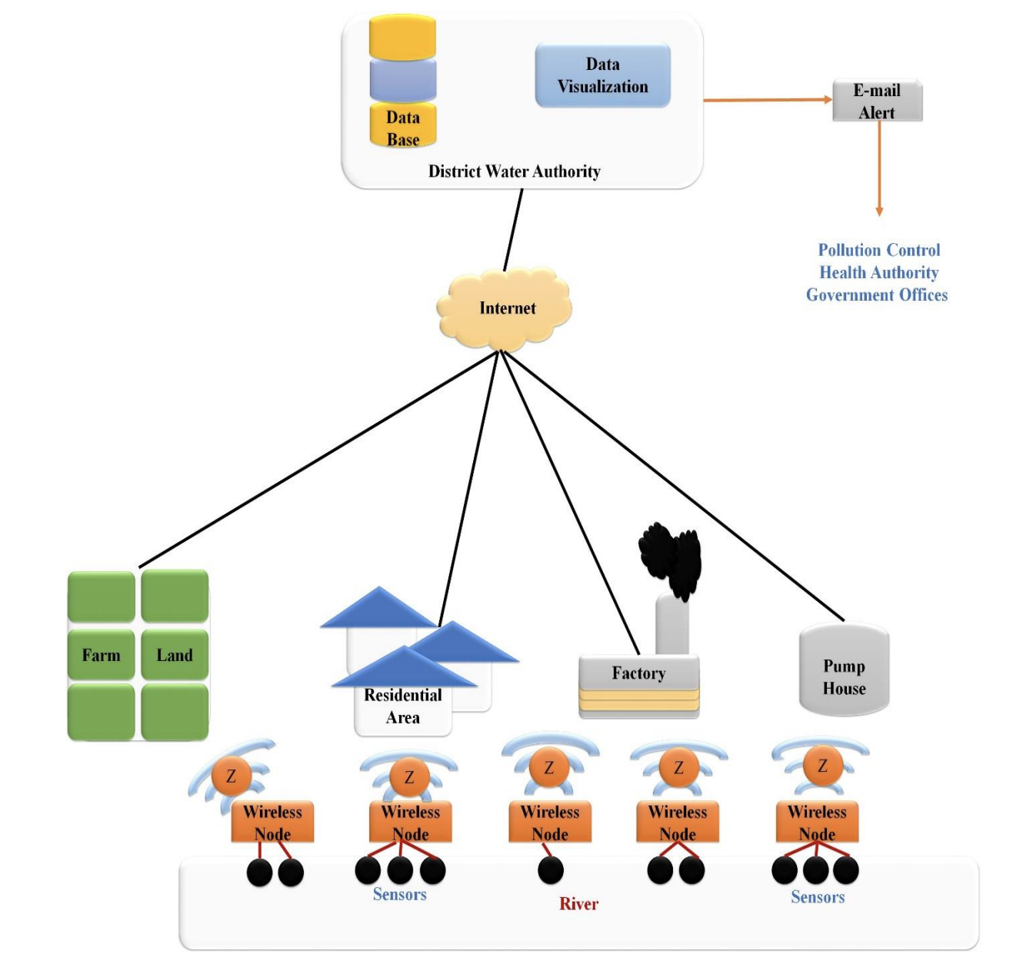
SMART City - WATER

Slide 9
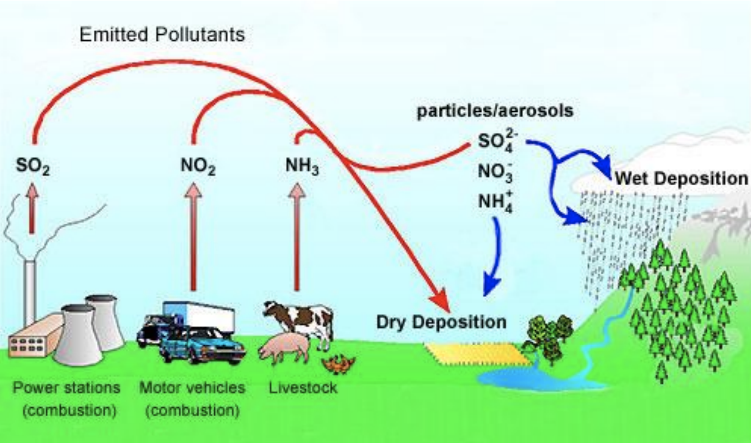
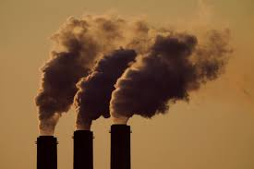
SMART City - air
Burning of Fossil Fuels
Agricultural Activities
Animal breeding /Grow crops
Factories and Industries
Mining operations
Indoor air quality
80% of all cancers are attributed
to environmental
Notes:
gases from cooking and heating
Chemicals from candles and household cleansers

Slide 10
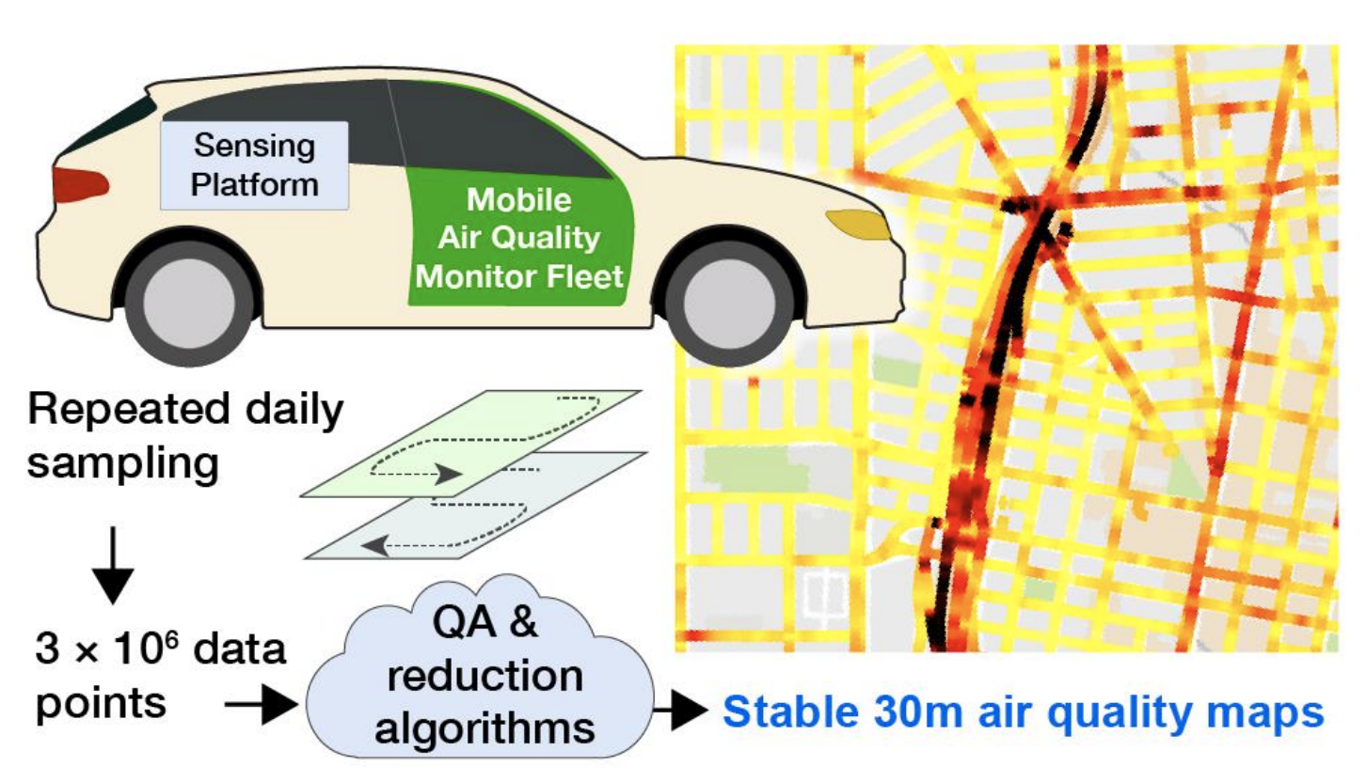
SMART City - air
Notes:
Air Monitoring by Vehicular Sensor Network
The low cost portable ***ambient sensors *** provide a huge opportunity in increasing the spatiotemporal resolution of the air pollution information and are even able to verify, fine tune or improve the existing ambient air quality models.
One of the most important complete air monitoring based IoT system is known as vehicular sensor network
Figure: sensor nodes typically carried by the public transportations like buses or taxis
Each sensor node utilizes a GPS module for acquiring time + location information and a ** Bluetooth link *** for communicating with the laptop inside car.
*** CO2 sensor *** for example mounted outside the car to monitor the concentration of CO2.
A ZigBee intra vehicle wireless network utilized to communicate with the inside car processing unit

Slide 11
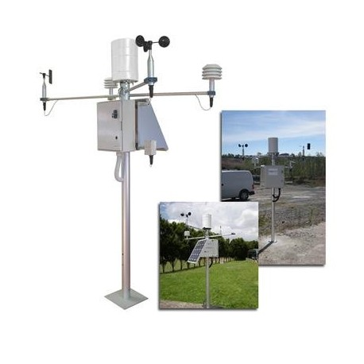
SMART City - weather
Modern weather monitoring systems are based on wireless technology consist of many monitoring bases stations.
The base stations consist of different types of sensing units such as
temperature measurement,
humidity measurement,
atmospheric pressure measurement,
air quality measurement,
rainfall measurement,
wind speed
wind direction measurement.

Slide 12
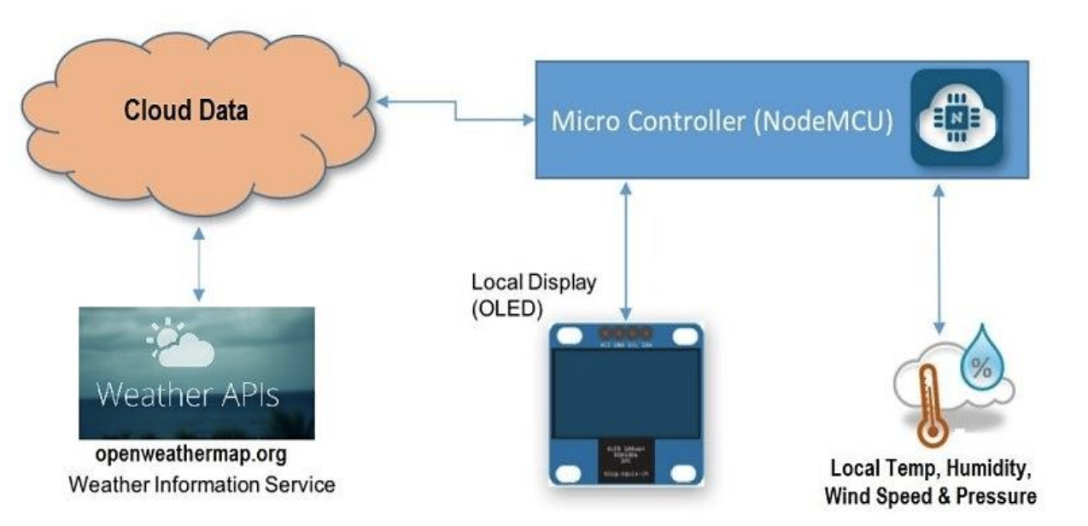
SMART City - weather

Slide 13
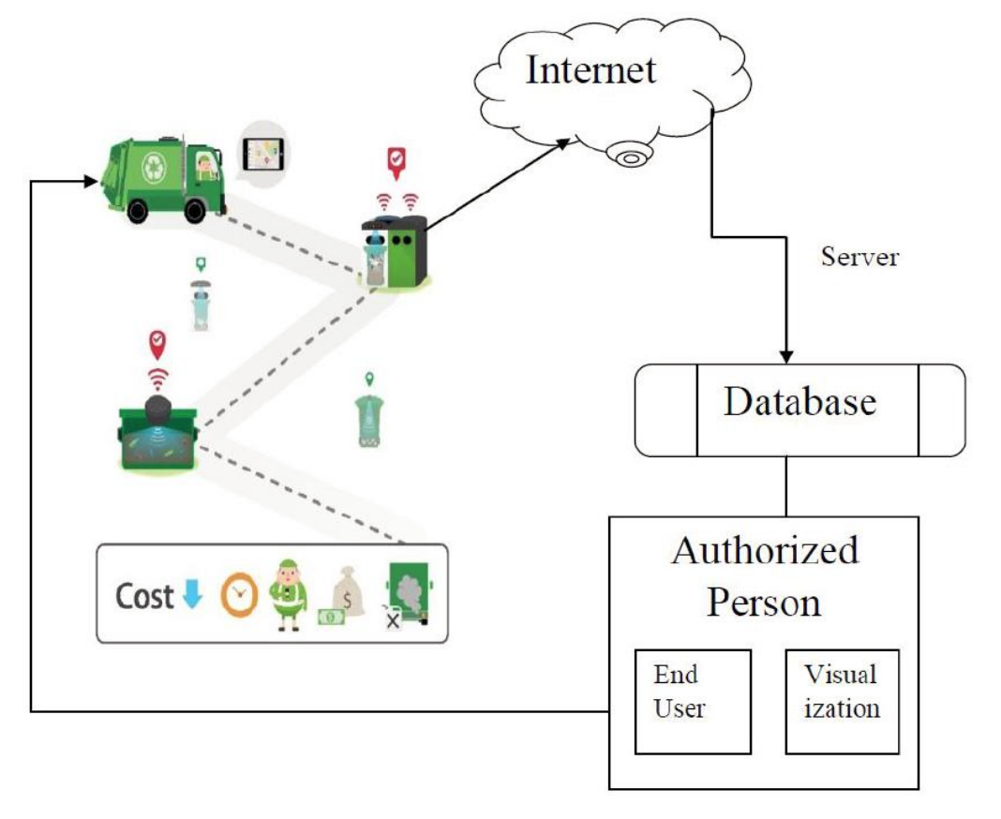
SMART City – WASTE COLLECTION
The average Nevadan produces nearly 8 pounds of garbage per person every day.
That's nearly twice the national average
implementation of smart waste collection system
will add a great value in smart cities projects by
design multiple dustbins located throughout the city
provide them with a sensor to track
the level and weight of the garbage bins
add a unique ID for every dustbin in the city
4. identify which garbage bin is full

Slide 14
Smart Environment Based IoT Applications Challenges
Definition and Identification
several thousands of devices and objects can be connected by the IoT for different services.
Each of these object needs to be uniquely identified over the network
Data Conversion:
conversion of data from one format to another.
making the data compatible for further processing
Interoperability
Develop systems with their interfaces completely understood, to work with other products or systems
Interoperability of all devices such as sensors and objects
Data Security
Develop proper security mechanism against attacks

